Slide 1

Slowly Changing Dimensions
By
By
Ahmed Mohamed Fathy

Slide 2
Introduction
Slowly changing dimensions (SCDs) are a common concept in data warehousing that refer to dimensions that change over time.
In data warehousing, dimensions are the characteristics or attributes that describe the data, such as customer information, product information, or time information.
SCDs are important because they allow businesses to keep track of historical data and analyze data at different points in time.
There are different types of SCDs, and the choice of SCD type depends on the business requirements and the importance of historical data.
In this presentation, we will discuss the three main types of SCDs and provide examples of when to use each type. We will also discuss the advantages and disadvantages of each type and provide guidance on how to choose the right SCD type for your data warehousing needs.

Slide 3
Types of Slowly Changing Dimensions
There are three main types of Slowly Changing Dimensions (SCDs):
Type 1, Type 2, and Type 3.
Each type has a different approach to managing changes to the dimension data over time.
Type 1:
In Type 1 SCD, the dimension data is overwritten with the new data whenever a change occurs.
This means that the historical data is lost, and only the current data is kept.
Type 1 is suitable for situations where historical data is not important, and the dimension data changes frequently.

Slide 4
Types of Slowly Changing Dimensions Cont.
Type 2:
In Type 2 SCD, a new record is created whenever a change occurs in the dimension data.
The new record includes the changed data as well as the valid time period for which it is effective.
This approach preserves historical data and allows for analysis of data at different points in time.
Type 2 is suitable for situations where historical data is important and the dimension data changes infrequently.
Type 3:
In Type 3 SCD, a separate attribute is added to the existing record to capture the change.
The attribute can be used to indicate a change in a specific dimension attribute and can only capture a limited number of changes.
Type 3 is suitable for situations where historical data is important, but the dimension data changes infrequently and the changes can be captured using a limited number of attributes.

Slide 5
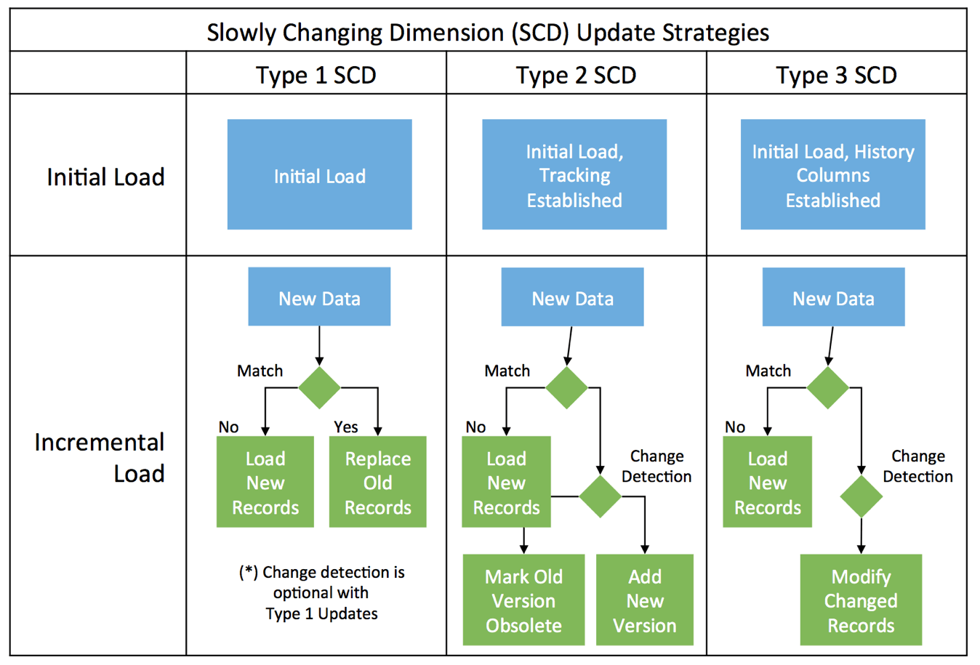
Types of Slowly Changing Dimensions Cont.

Slide 6
Advantages and Disadvantages of Slowly Changing Dimensions
Each type of Slowly Changing Dimension (SCD) has its own advantages and disadvantages, and the choice of SCD type depends on the business requirements and the importance of historical data.
Type 1:
Advantages:
Simple and easy to implement.
Consumes less storage space.
Disadvantages:
Historical data is lost.
Does not allow for analysis of data at different points in time.

Slide 7
Advantages and Disadvantages of Slowly Changing Dimensions Cont.
Type 2:
Advantages:
Preserves historical data.
Allows for analysis of data at different points in time.
Disadvantages:
Consumes more storage space.
Requires additional processing to manage the historical data.
Type 3:
Advantages:
Preserves historical data to a limited extent.
Consumes less storage space than Type 2.
Disadvantages:
Can only capture a limited number of changes.
Does not allow for analysis of data at different points in time to the same extent as Type 2.

Slide 8
Choosing the Right Slowly Changing Dimension Type
Choosing the right Slowly Changing Dimension (SCD) type depends on several factors, such as the importance of historical data, the frequency of changes, and the available storage space.
Type 1:
Use Type 1 if historical data is not important, and the dimension data changes frequently.
Examples include customer contact information or product pricing.
Type 2:
Use Type 2 if historical data is important, and the dimension data changes infrequently.
Examples include customer demographics or product attributes.

Slide 9
Choosing the Right Slowly Changing Dimension Type Cont.
Type 3:
Use Type 3 if historical data is important, the dimension data changes infrequently, and the changes can be captured using a limited number of attributes.
Examples include customer preferences or product availability.
It is also possible to use a combination of SCD types for different attributes within the same dimension, depending on the specific business requirements.
Remember that the choice of SCD type has implications for storage, processing, and analysis, so it is important to carefully consider the trade-offs and choose the right type for your data warehousing needs.

Slide 10
Best Practices for Implementing Slowly Changing Dimensions
Implementing Slowly Changing Dimensions (SCD) requires careful planning and execution to ensure data accuracy and consistency. Here are some best practices to consider:
Define Business Rules:
Clearly define the business rules for each SCD type to ensure that the implementation aligns with the business requirements.
Use Standard Naming Conventions:
Use standard naming conventions for dimension attributes to ensure consistency and avoid confusion.
Create Data Quality Rules:
Develop data quality rules to ensure that the data is clean and accurate before it is loaded into the data warehouse.

Slide 11
Best Practices for Implementing Slowly Changing Dimensions Cont.
Implement Auditing:
Implement auditing and logging to track changes to the dimension data and ensure accountability.
Test Thoroughly:
Test the SCD implementation thoroughly to ensure that it works as expected and produces the desired results.
Monitor Performance:
Monitor the performance of the SCD implementation and make adjustments as needed to optimize performance and ensure scalability.
By following these best practices, you can ensure that your SCD implementation is accurate, consistent, and aligned with your business requirements.

Slide 12
Conclusion
Slowly Changing Dimensions (SCD) are an important concept in data warehousing that enable organizations to manage and analyze historical data accurately and efficiently. By implementing SCD, organizations can ensure that their dimension data is consistent, accurate, and aligned with their business requirements.
In this presentation, we discussed the different types of Slowly Changing Dimensions and how they are implemented in data warehousing. We also discussed best practices for implementing SCD, and the benefits they can provide for organizations.
In summary, Slowly Changing Dimensions are an essential component of modern data warehousing, and by following best practices and considering the benefits they can provide, organizations can gain valuable insights, make informed decisions, and achieve competitive advantages.

Slide 13
References
Kimball, Ralph, and Margy Ross. The Data Warehouse Toolkit: The Definitive Guide to Dimensional Modeling. Wiley, 2013.
Inmon, Bill, and Claudia Imhoff. Building the Data Warehouse. John Wiley & Sons, 2013.
Sapia, C. J., et al. "Slowly Changing Dimensions in Data Warehouses: An Overview and Case Study." Journal of Computing Sciences in Colleges, vol. 22, no. 2, 2006, pp. 151-159.
"Data Warehousing: Slowly Changing Dimensions." Oracle Help Center, Oracle Corporation, 2021, docs.oracle.com/cd/B28359_01/server.111/b28274/dimensional.htm.
"Slowly Changing Dimensions." Microsoft Docs, Microsoft Corporation, 2021, docs.microsoft.com/en-us/sql/integration-services/data-flow/slowly-changing-dimension-transform.

Slide 14
Thank You

